Slide 1

Board Game Complexity Analysis
Andy Brandt

Slide 2
Goal of Analysis
Use a t-test to determine if on average games receive a rating of 6.5 or higher out of 10
Do newer games take longer to play?
Are newer games more complex than older games?
Is there a correlation between a game’s complexity and how long it takes to play?
Is there a correlation between a game’s average rating and its complexity?

Slide 3
Dataset
Taken from Board Game Geek:
19,000+ board games
Average rating from game owners (out of 10)
Board game complexity (out of 5)
Average play time
Year published

Slide 4
Data Summary
Category | Minimum | Q1 | Median | Q3 | Maximum | Mean | Standard Deviation
Average Rating (/10) | 1.050 Oneupmanship: Mine's Bigger | 5.840 | 6.440 | 7.030 | 9.540 DEFCON 1 | 6.416 | 0.9177
Complexity (/5) | 1.000 War | 1.350 | 2.000 | 2.560 | 5.000 Empire (Third Edition) | 2.037 | 0.8021
Play Time (Minutes) | 1 Tic-Tac-Toe | 30 | 45 | 90 | 60000 The Campaign for North Africa: The Desert War 1940-43 | 94.99 | 559.2
Year Published | -3500 Senet | 2001 | 2011 | 2016 | 2022 The 7th Citadel | 2002 | 100.9

Slide 5
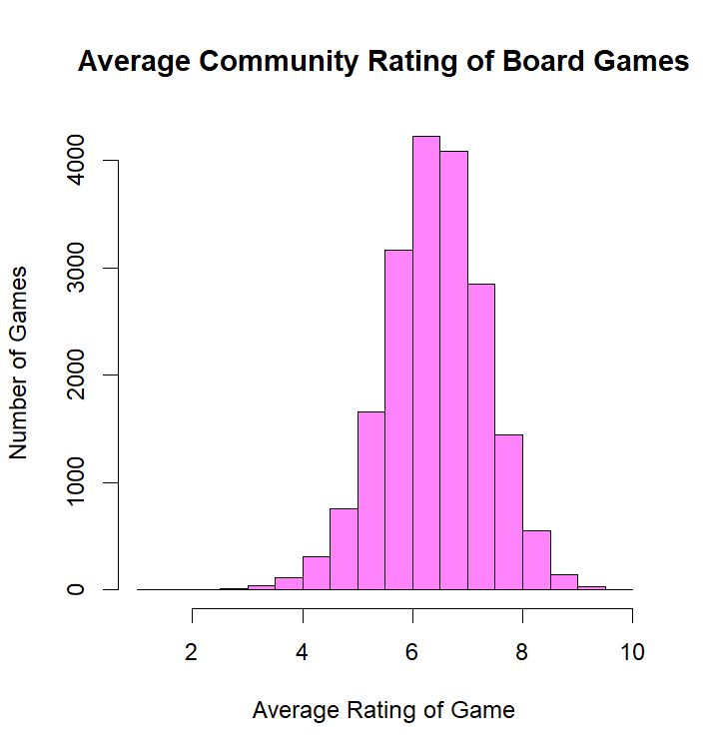
Average Rating
The simplest of the created graphs
Mean: 6.416
Left Skew
Most games land at about the 6.5/10 rating

Slide 6
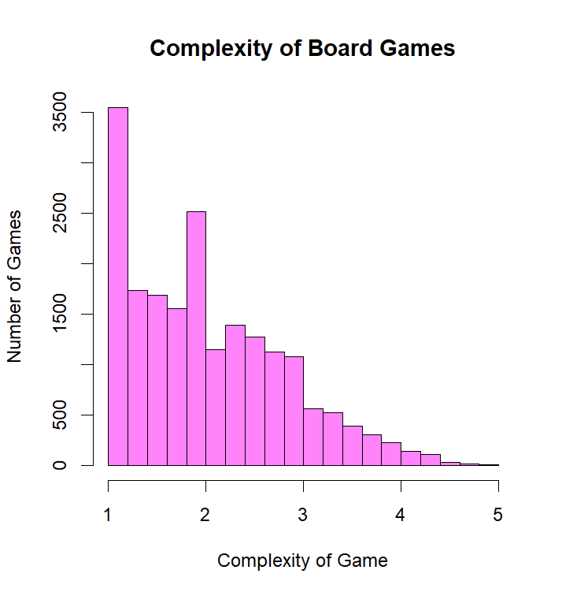
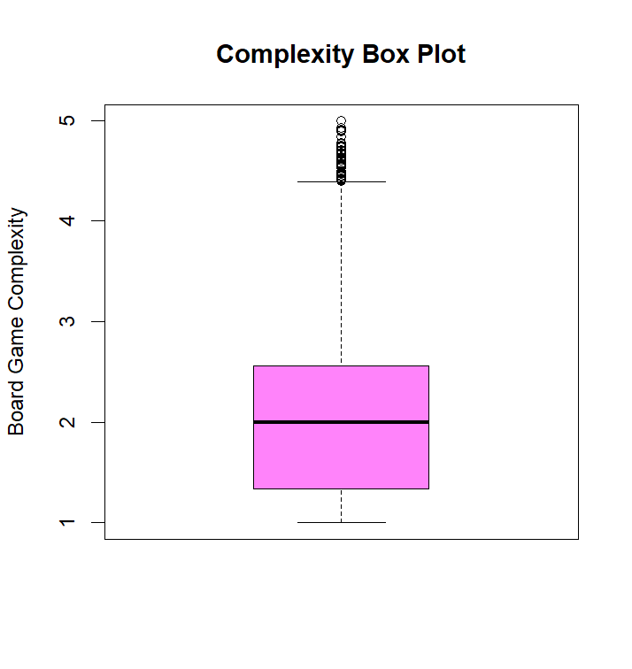
Average Complexity
Mean: 2.034
Right Skew
Majority of games have very low complexity

Slide 7
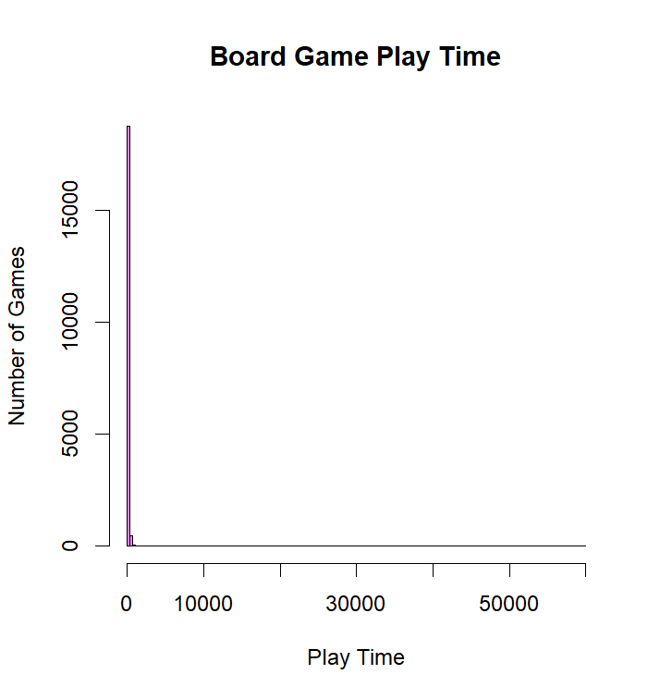
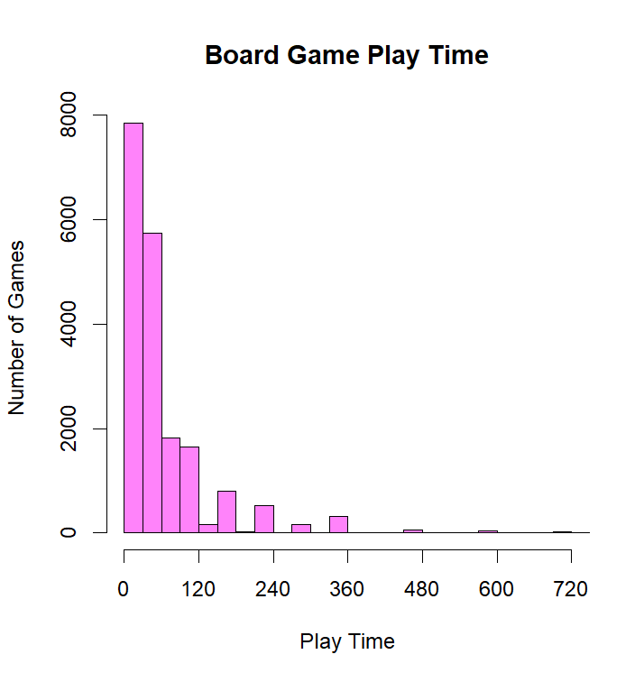
Play Time
SDs Away from Mean | Entries outside SD | SDs Away from Mean | Entries Outside SD
1 | 174 | 5 | 41
2 | 77 | 6 | 30
3 | 60 | 7 | 25
4 | 50 | 8 | 20
Mean: 94.57
  Max: 60000
Median: 45.00
Wildy Skewed Right
Near unusable due to “campaign” games
4.2% games > 4 hours
0.7% games > 12 hours

Slide 8
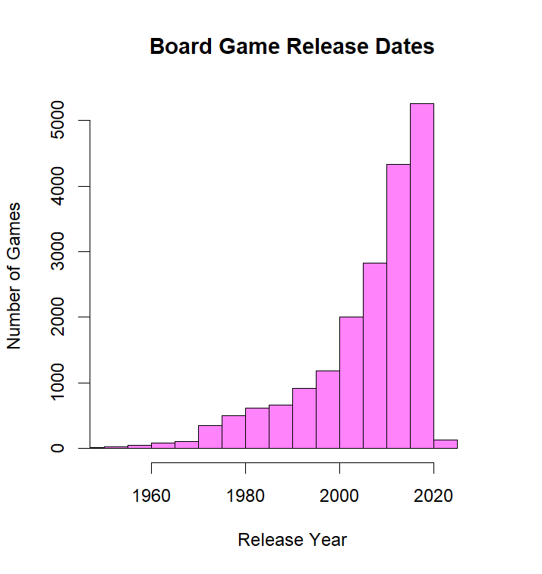
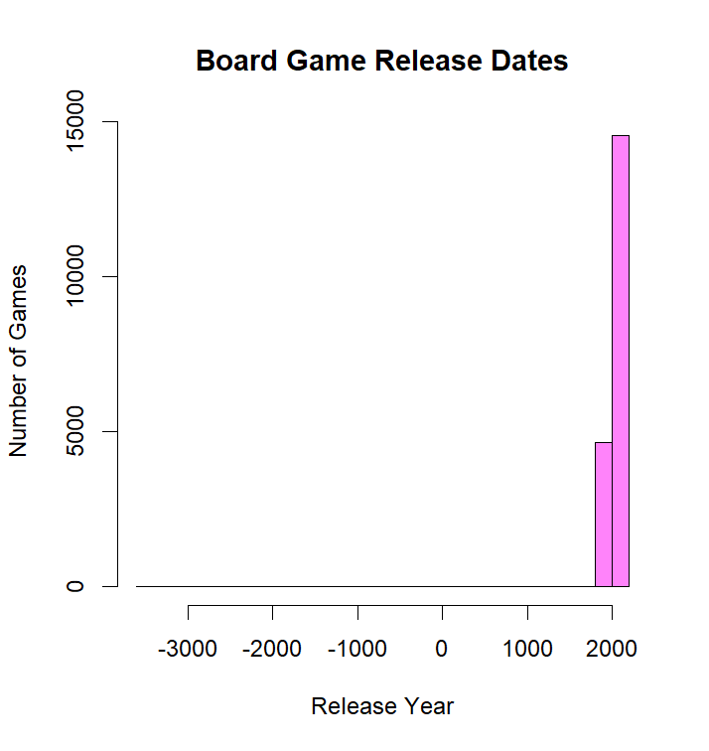
Year Published
Mean: 2002
Strong Left Skew
53 games created before 1750
77 before 1850
200 before 1950

Slide 9
T-Test on Rating
Name | Rating
Snarf Quest | 5.24
Malifaux (Second Edition) | 8.12
Bakari | 5.28
UNO H2O Splash | 6.00
Tetris (1989) | 5.59
Enchanters: Overlords | 7.55
Agricola: All Creatures Big and Small | 7.38
Tranquility Base | 7.05
Nichtlustig | 5.20
Blood Rage | 8.00
Hedbanz for Adults! | 5.39
Ticket to Ride: London | 7.24
Star Maps | 6.51
Terraforming Mars: Ares Expedition | 6.13
What's He Building in There? | 6.65
The Estates | 7.49
Orange Quest | 5.65
Barbeque Party | 5.07
1000 Bornes Express | 5.80
Espresso | 6.17
Warhammer Underworlds: Dreadfane | 8.05
Castle Dice | 6.67
On the Hunt for Dinos | 5.84
Monopoly: The Legend of Zelda | 5.56
The Whatnot Cabinet | 7.52
I would like to believe that most board games are good
This can be shown if, on average, a board game is ranked at least 6.5 out of 10. I will also test this at a 5% significance level
25 randomly chosen games are shown on the right, I will use these to conduct the t-test.

Slide 10
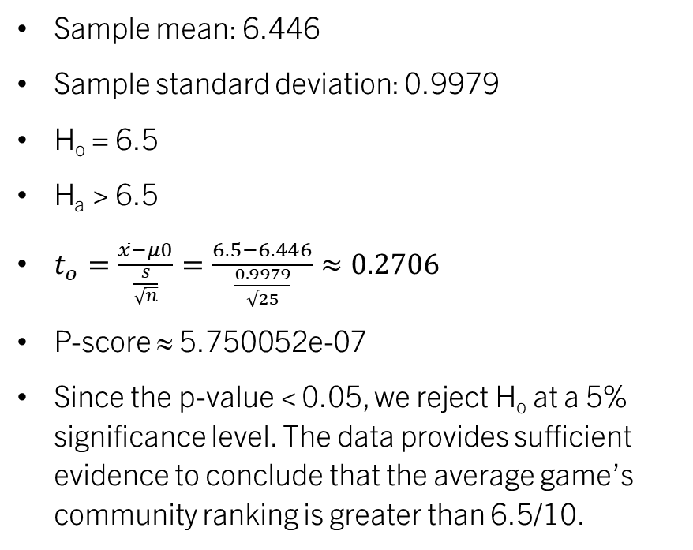
T-Test on Rating
Name | Rating
Snarf Quest | 5.24
Malifaux (Second Edition) | 8.12
Bakari | 5.28
UNO H2O Splash | 6.00
Tetris (1989) | 5.59
Enchanters: Overlords | 7.55
Agricola: All Creatures Big and Small | 7.38
Tranquility Base | 7.05
Nichtlustig | 5.20
Blood Rage | 8.00
Hedbanz for Adults! | 5.39
Ticket to Ride: London | 7.24
Star Maps | 6.51
Terraforming Mars: Ares Expedition | 6.13
What's He Building in There? | 6.65
The Estates | 7.49
Orange Quest | 5.65
Barbeque Party | 5.07
1000 Bornes Express | 5.80
Espresso | 6.17
Warhammer Underworlds: Dreadfane | 8.05
Castle Dice | 6.67
On the Hunt for Dinos | 5.84
Monopoly: The Legend of Zelda | 5.56
The Whatnot Cabinet | 7.52
Sample mean: 6.446
Sample standard deviation: 0.9979
H_{o} = 6.5
H_{a} > 6.5
$t_{o}=\frac{\overline{x}−μ0}{\frac{s}{\sqrt{n}}}=\frac{6.5−6.446}{\frac{0.9979}{\sqrt{25}}}≈0.2706$
P-score ≈ 5.750052e-07
Since the p-value < 0.05, we reject H_{o} at a 5% significance level. The data provides sufficient evidence to conclude that the average game’s community ranking is greater than 6.5/10.

Slide 11
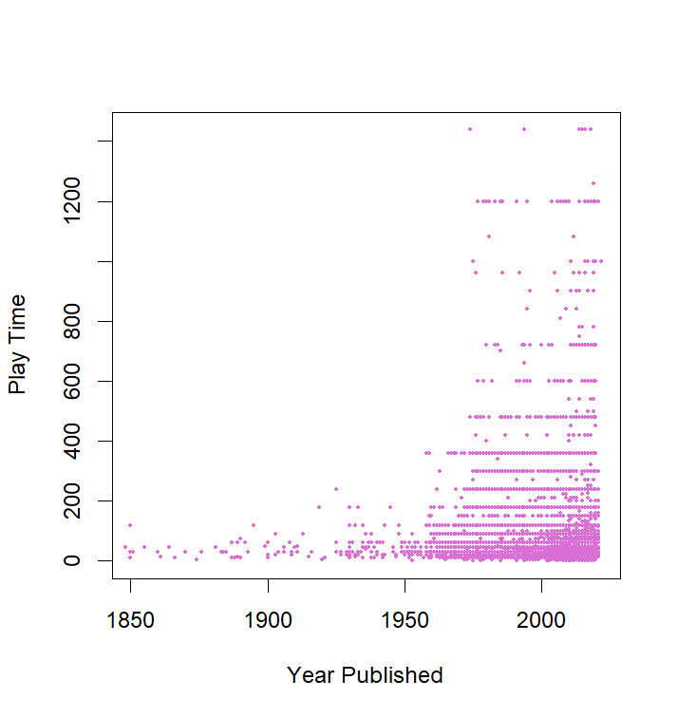
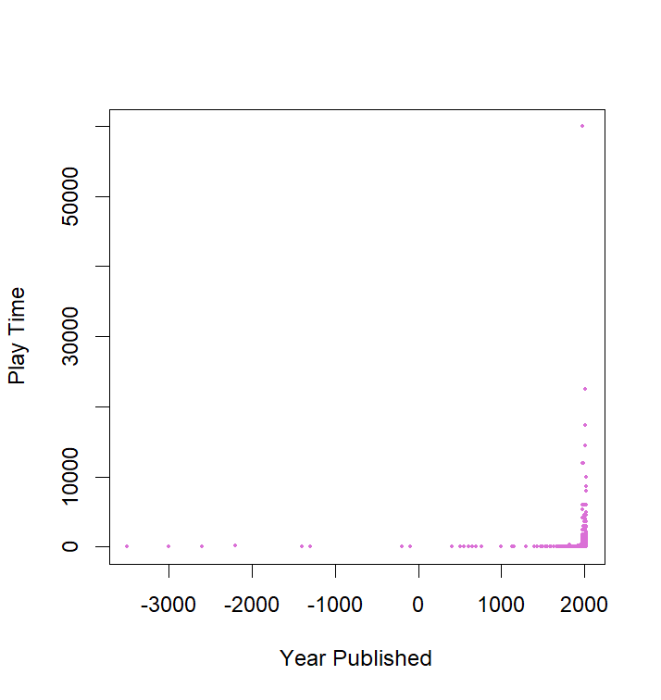
Correlation
Year Vs. Play Time
No Correlation in the slightest
-0.0008690 correlation
Lines of dots come from common time rounding
  15 min, 30 mins, 60 mins, etc.

Slide 12
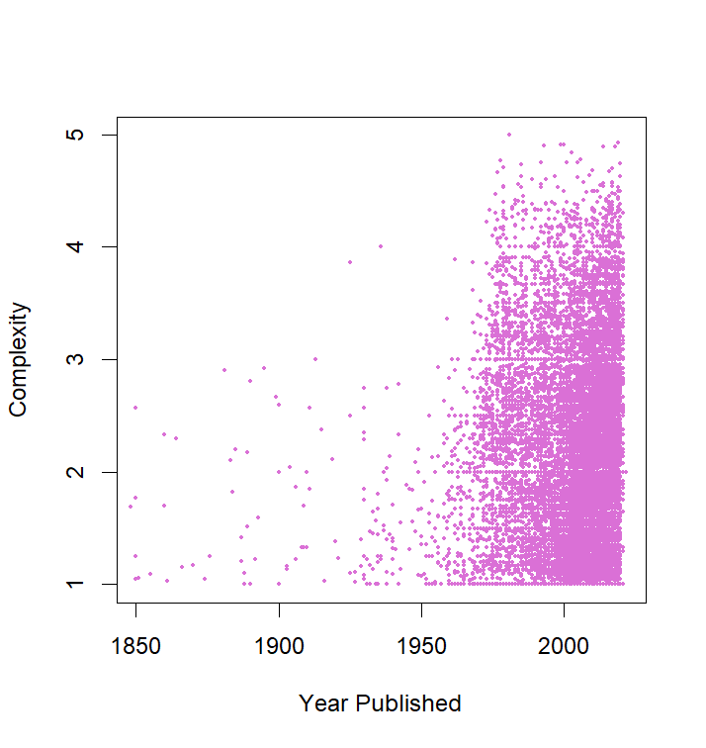
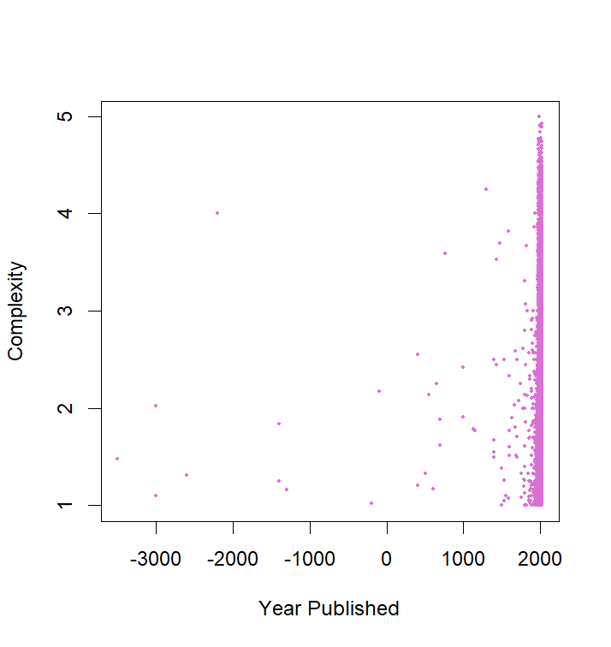
Correlation
Year Vs. Complexity
Still no correlation
0.006162 correlation
There will always be a higher concentration of simple games regardless of decade

Slide 13
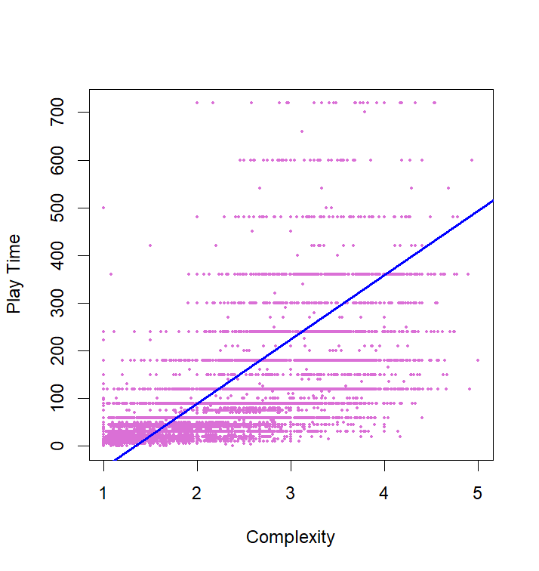
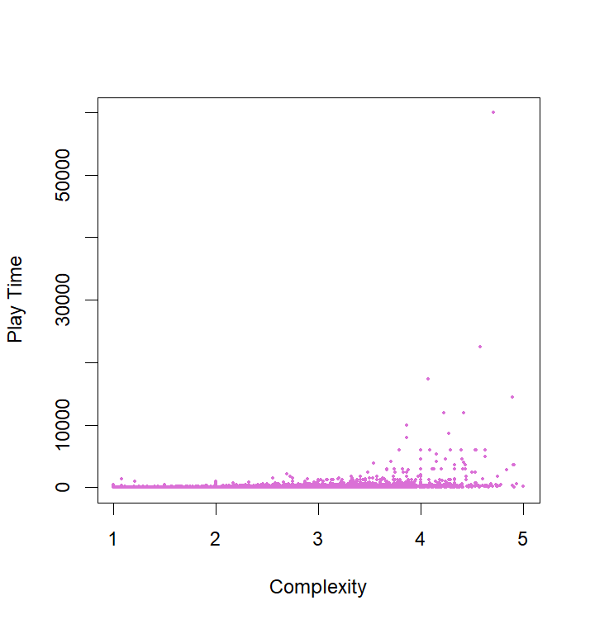
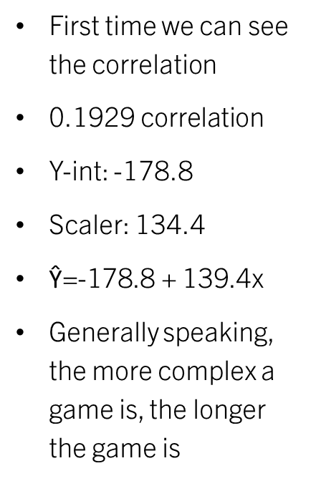
Linear Regression
Play Time Vs. Complexity
First time we can see the correlation
0.1929 correlation
Y-int: -178.8
Scaler: 134.4
$\text{Ŷ=}\text{-178.8 }\text{+}\text{ 139.4}\text{x}$
Generally speaking, the more complex a game is, the longer the game is

Slide 14
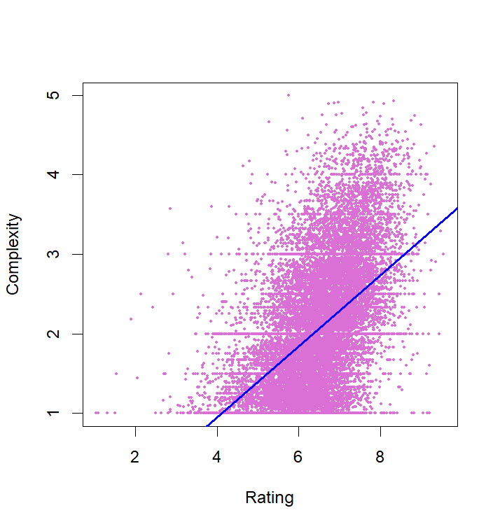
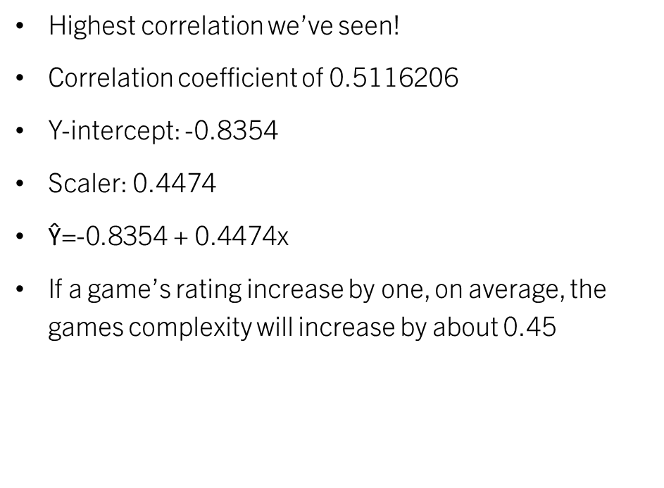
Linear Regression
Rating Vs. Complexity
Highest correlation we’ve seen!
Correlation coefficient of 0.5116206
Y-intercept: -0.8354
Scaler: 0.4474
$\text{Ŷ}\text{=-0.8354 + 0.4474}\text{x}$
If a game’s rating increase by one, on average, the games complexity will increase by about 0.45

Slide 15
Conclusion
It seems that the year a game was published has no influence on a game’s complexity or how long it takes to complete the game.
In fact, there isn’t even a strong correlation between a game's complexity and its play time, only a loose connection.
The only correlation we have is a games rating and how complex the game is. After all, people will get tired of simple game much quicker than they would a game with a lot of moving pieces or difficult mechanics.

